Slide 1
EDU GRAPH-API Demo Script
Expertise in Microsoft's Azure, Office 365, and SharePoint platforms

Slide 2
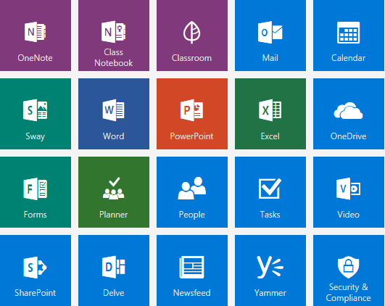
Agenda
Admin Login Authentication Flow
Local Login Authentication Flow
O365 Login Authentication Flow
ALL SCHOOLS
SCHOOL CLASSES
CLASS DETAILS
Teachers/Students
Demo Helper

Slide 3
Admin Account Login Authentication Flow

Slide 4
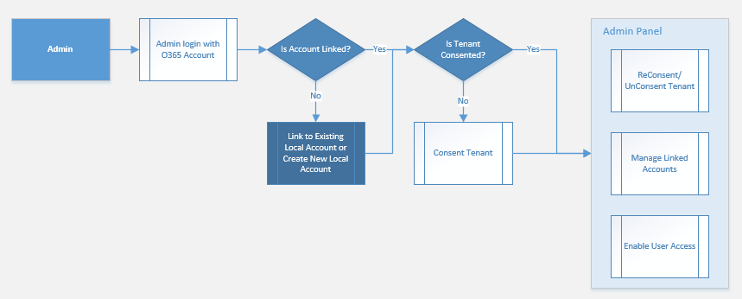
Admin Account Login Authentication Flow

Slide 5
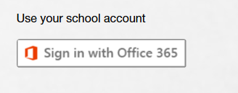
Admin Login with an Office 365 Account
Go to the site login page.
Click the Sign in with Office 365 button.
Login with the Admin account.

Slide 6
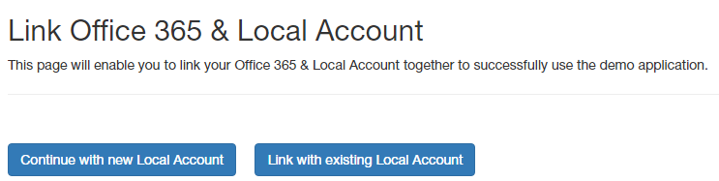
Is Admin Account Linked to a Local Account?
Is the Admin account linked to a local account?
Admin can link with an existing local account.
Admin can create a local account and then link.

Slide 7
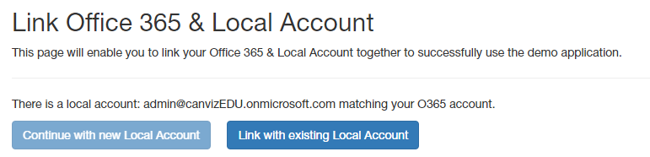
Link the Admin Account to Existing Local Account
If a local account already exists with the same email as O365 email, Continue with new Local Account button will be disabled.
If you have a local account, click Link with existing Local Account will link O365 account to local account.
After link succeed it will go to all schools page.
Admin can also go to admin panel on top navigation.

Slide 8
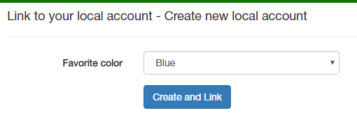
Create Local account and Link
If there’s no local account admin can create a new local account and then link.
Select favorite color and then click Create and Link button.

Slide 9
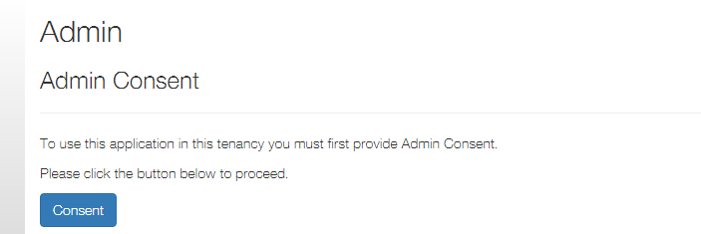
Admin Panel
Admin needs to consent when first go to admin panel.
Click Consent button to login and accept and then consent success.

Slide 10
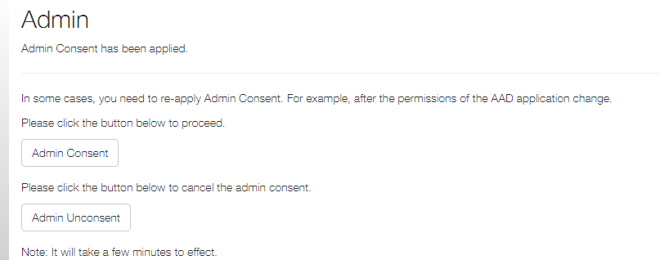
Admin Panel - Admin Consent and Unconsent
Admin can click consent and unconsent buttons to apply/re-apply admin consent.
If clicks consent and unconsent buttons admin needs to login again and then continue.

Slide 11
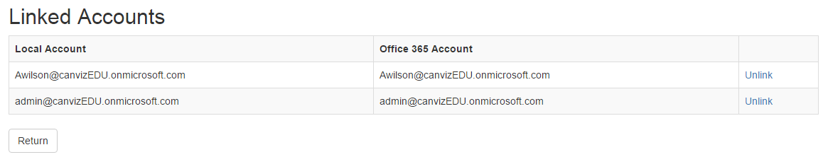
Admin Panel - Manage linked accounts
All linked users are displayed here.
Click the Unlink link to unlink a user.

Slide 12
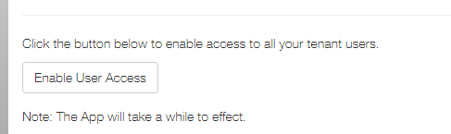
Admin Panel - Enable User Access
Admin can click Enable User Access button to enable access to all tenant users.
It will take a while to effect after the button is clicked.

Slide 13
Admin Panel – Clear Login Cache
Admin can click Clear Login Cache button to reset a login cache.

Slide 14
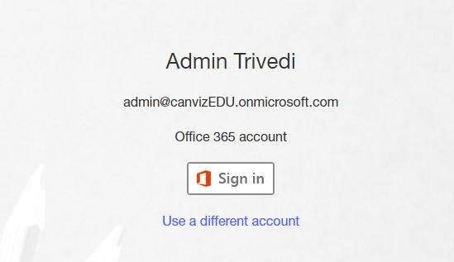
Admin – login with O365 account
Once the user has authenticated successfully with O365 and has linked their account, the O365 auth option will appear predominantly as the option to authenticate

Slide 15
Local Account Login Authentication Flow

Slide 16
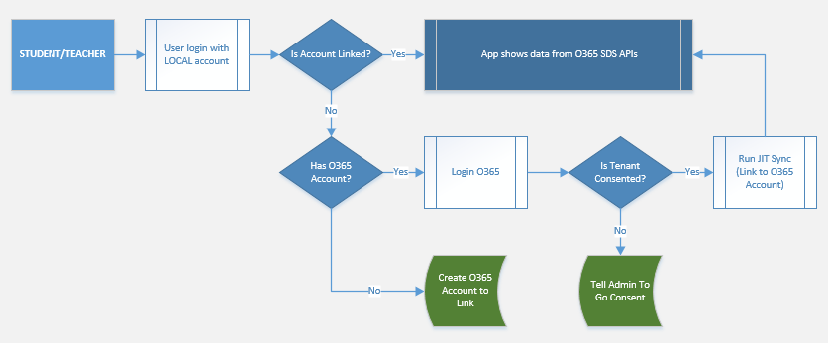
Local Account Login Authentication Flow

Slide 17
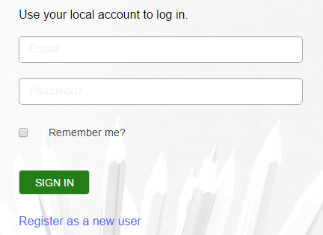
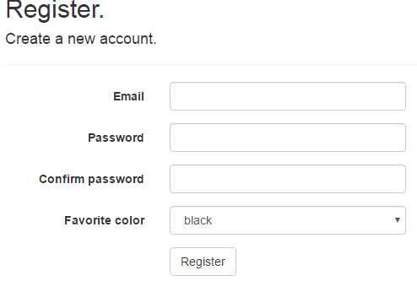
Create Local Account
Go to site login page and click the Register as a new user link.
Fill the form fields: Email, Password etc. , then click the Register button.

Slide 18
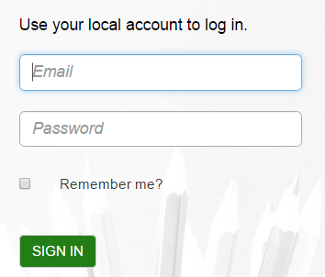
Login with the Local Account
Go to the site login page.
Input email and password.
Click the SIGN IN button.

Slide 19
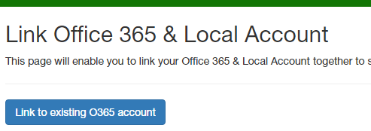
Link the Local Account to an Office 365 Account
Click the Link to existing O365 account button to login and then link the accounts.
After link succeed it will go to all schools page.

Slide 20
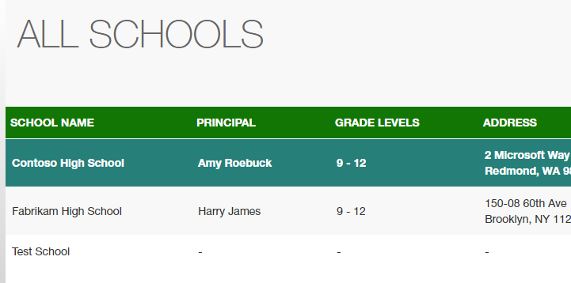
Login succeeded
After linking the accounts succeeds the app displays all schools.

Slide 21
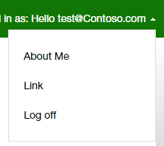
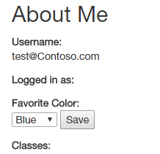
About Me
Click username on top right corner and click “About Me”.
Username will display here.
User’s favorite color will show here and user can change and save it.
If user is linked to O365 his(her) classes will display here.

Slide 22
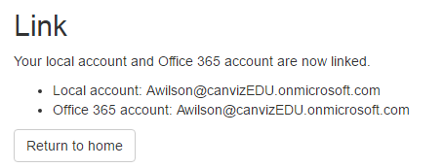
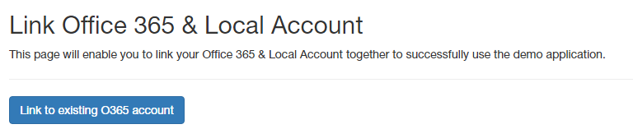
Link
Click username on top right corner and click “Link”.
Here will display link status if account is linked to O365 account.
If local account is not linked to O365 account it will show option “Link to existing O365 account” and then link.

Slide 23
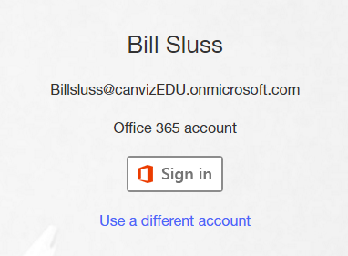
login with O365 account
Once the user has authenticated successfully with O365 and has linked their account, the O365 auth option will appear predominantly as the option to authenticate

Slide 24
Office 365 Login Authentication Flow

Slide 25
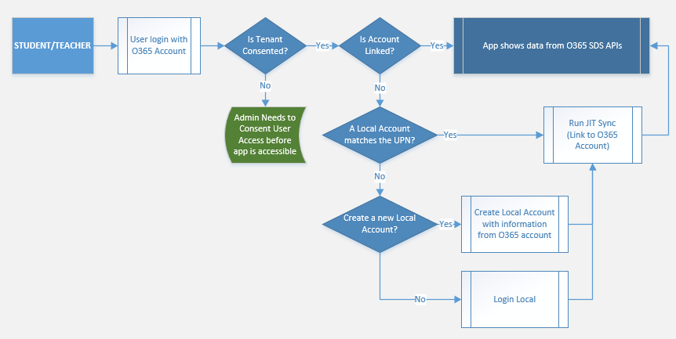
Office 365 Login Authentication Flow

Slide 26
Login with Office 365 Account
Go to the site login page.
Click the Sign in with Office 365 button.
Login with an Office 365 account.

Slide 27
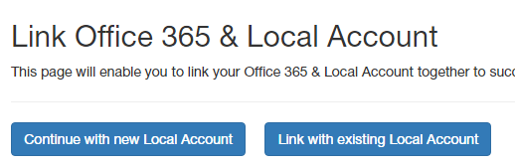
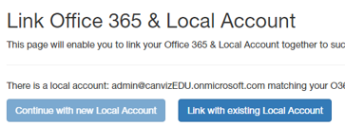
Link an Office 365 Account to a Local Account
Click the Link with existing Local Account button to link the account to an existing account.
Click Continue with new Local Account to create a new local account and then link.

Slide 28
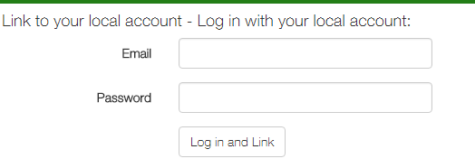
Login with a Local Account and Link the accounts
Input local account’s email and password and then click Login and Link button to link.
If there’s a local account with the same email as O365 email, these input fields will no show and link directly.

Slide 29
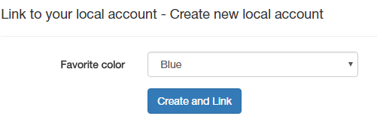
Create a Local Account and Link the accounts
Select Favorite color.
Click the Create and Link button to create a new local account and then link the accounts.

Slide 30
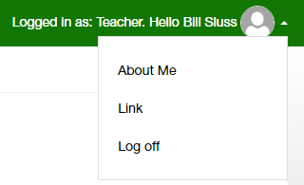
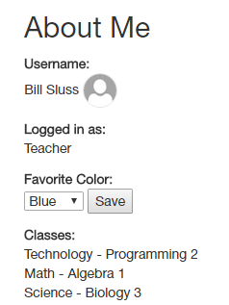
About Me
Click username on top right corner and click “About Me”.
Username will display here.
User’s favorite color will show here if linked to local account and user can change/save it.
User classes will display here.

Slide 31
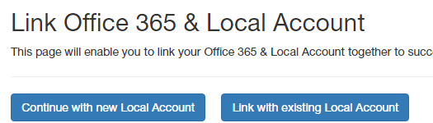
Link
Click username on top right corner and click “Link”.
Here will display link status if account is linked to local account.
If O365 account is not linked to local account it will show link options like “Continue with new Local Account” or “Link with existing Local Account”.

Slide 32
login with O365 account
Once the user has authenticated successfully with O365 and has linked their account, the O365 auth option will appear predominantly as the option to authenticate

Slide 33
ALL SCHOOLS

Slide 34
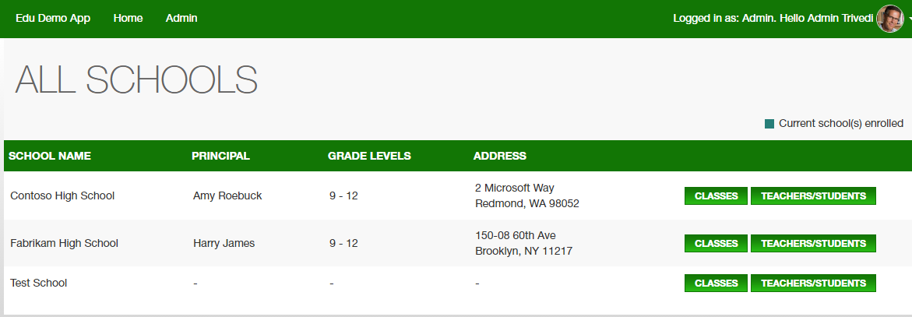
ALL SCHOOLS
Login with a teacher/student account & go to the all schools page.
Teacher/student’s id is displayed in the top right corner.
Current school(s) enrolled are marked with green color.
Click CLASSES to go to the classes page.
Click Teachers/students to show teachers/students of current school.

Slide 35
SCHOOL CLASSES

Slide 36
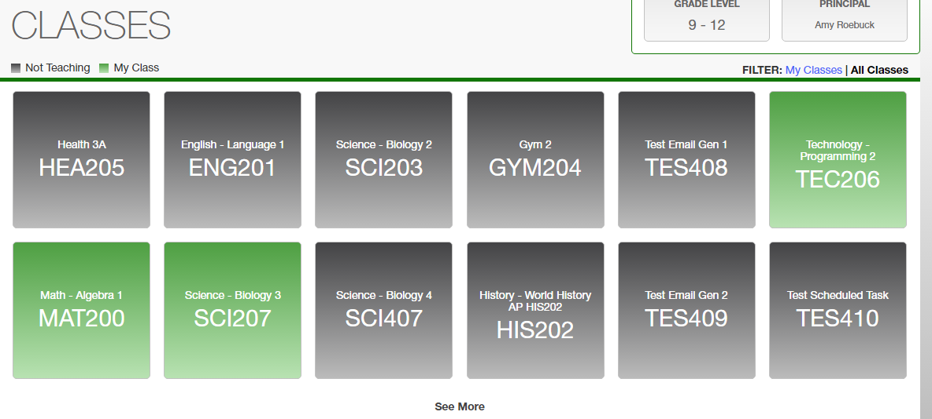
SCHOOL CLASSES
All classes are displayed on the school classes page.
My classes are highlighted with a green color.
Classes that the current users are highlighted with the gray color.
Hover on a class to pop up the class details window.
Click on a green highlighted class to go to the class detail page.
Click the My Classes or All Classes links to switch views.

Slide 37
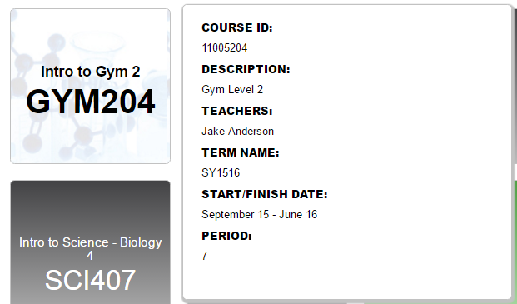
Class detail information
Hover on a class tile to pop up the class detail window.

Slide 38
CLASS DETAILS

Slide 39
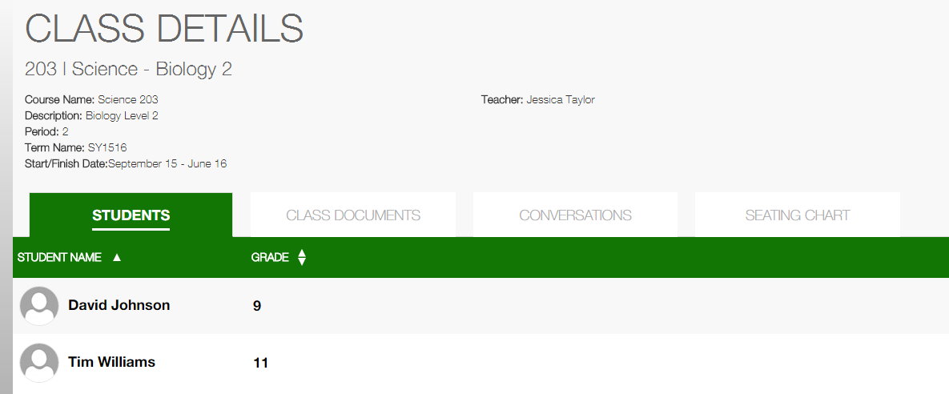
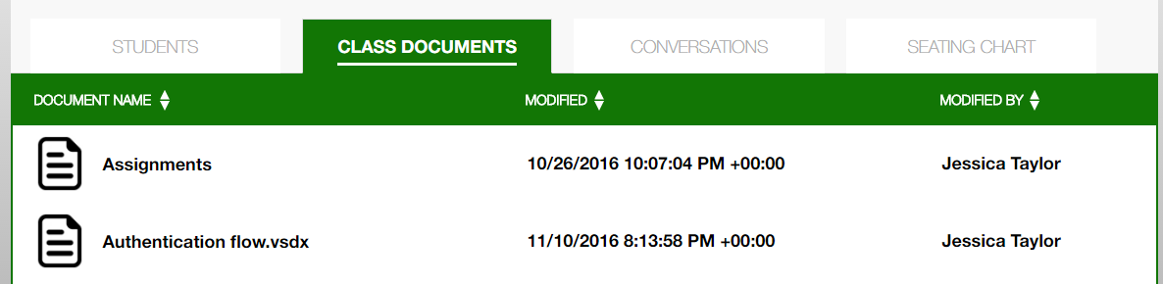
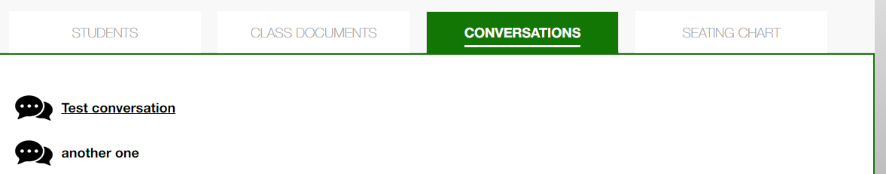
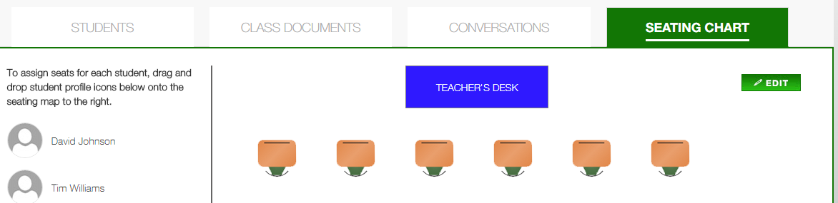
Class detail
Class detail are displayed on this page.
There are 4 tabs containing students, class documents, conversations and seating chart.
Click each tab to see detailed information.

Slide 40
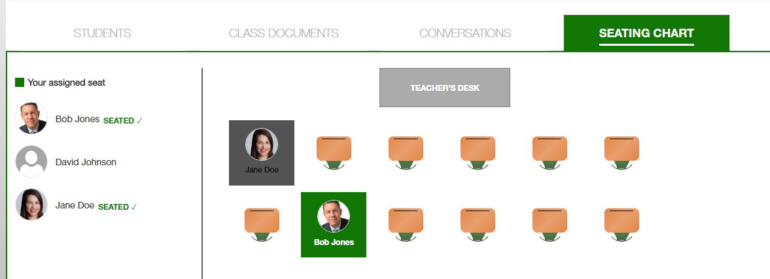
Class detail seating chart – login as a student
When login as a student, his assigned seat will display on the chart.
Current student’s seat will high lighted with the color of his favorite color.
Other students’ seat will show with their own favorite color.

Slide 41
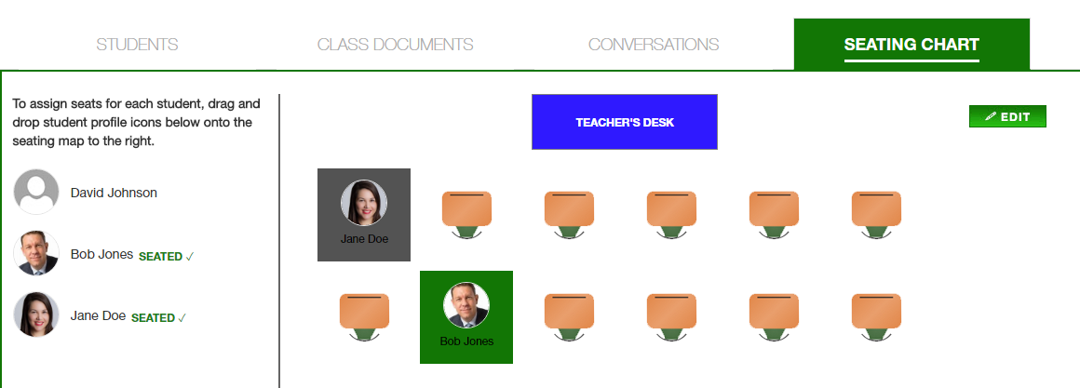
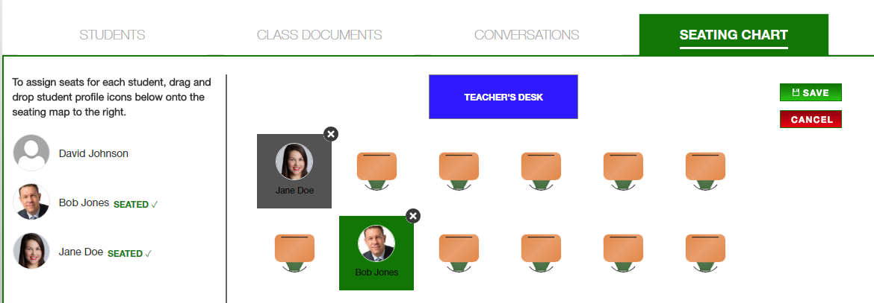
Class detail seating chart – login as a teacher
When login as a teacher, he can see all students’ seat on the chart.
A teacher can click edit button and then drag/drop/delete a student’s seat.
A teacher can save or cancel edit.

Slide 42
Teachers/Students

Slide 43
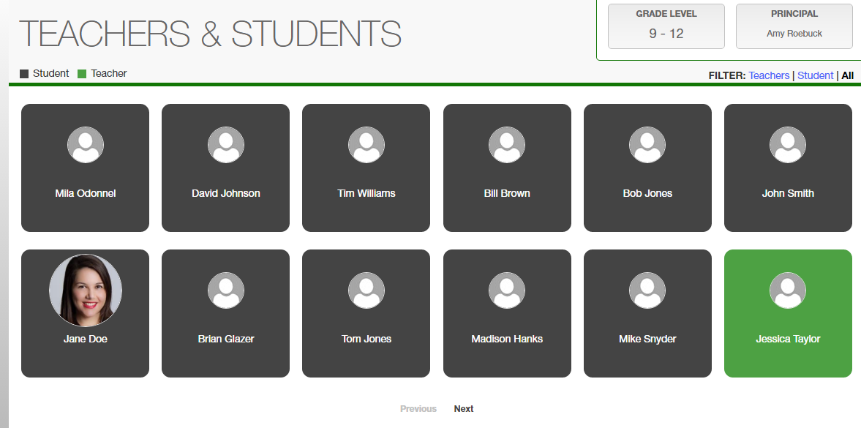
ALL SCHOOLS – Teachers/Students
Click Teachers/students on all schools page and then go to all users page.
All teachers/students will list here.
Click the filter on top right corn to filer teachers/students.
teachers/students will be displayed with paginations.

Slide 44
Demo Helper

Slide 45
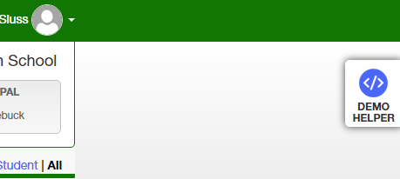
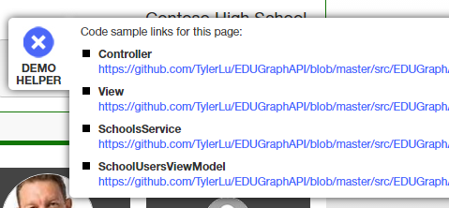
Demo Helper
Click Demo Helper on top right corner to open helper.
It will show information like Controller, View, Services, ViewModel of current page.
Click X to hide helper.

Slide 46
Sync Data With Web Job

Slide 47
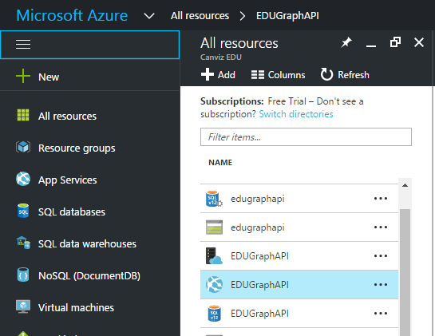
Sync Data With Web Job
Got to https://portal.azure.com and login with the admin account.
Click All resources on the left side of the page. All resources are displayed.
Click the App Service named EDUGraphAPI.

Slide 48
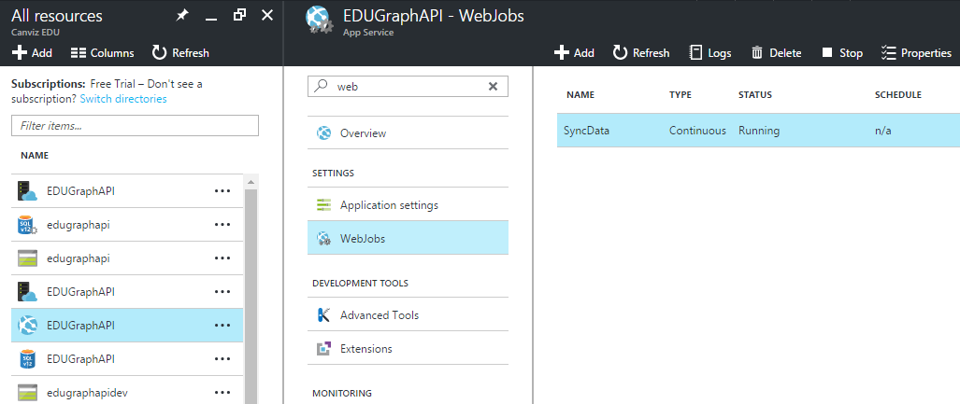
Web Jobs
In the Settings group, click Web Jobs.
Select the job named SyncData, then click Logs.

Slide 49
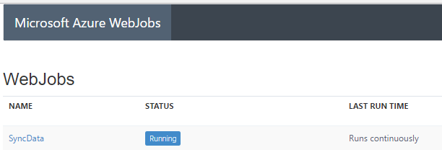
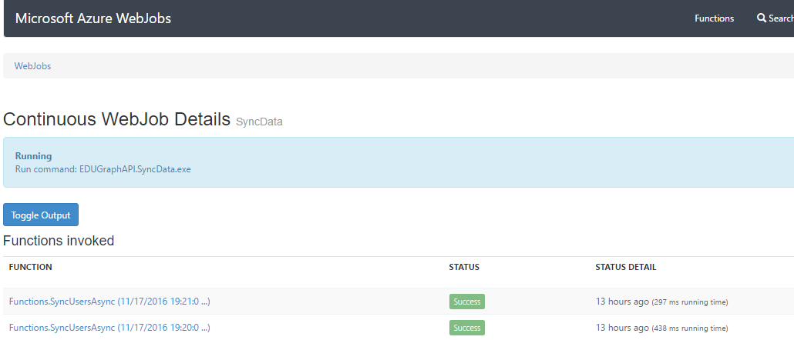
Web Job Logs
Click the SyncData link to see Log details.
On Log detail page click the Toggle Output button to show Log details.

Slide 50
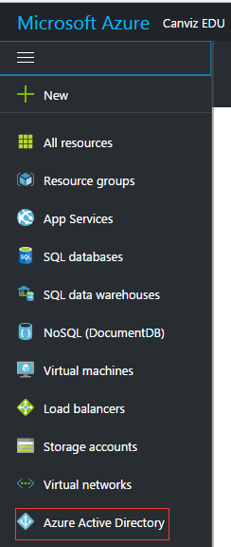
Update AD User Information
Got to https://portal.azure.com and login with the admin account.
Click Azure Active Directory icon on left navigation panel.
The AD named Canviz EDU will show.
If the default AD opened is not Canviz EDU, switch AD by click user icon on top right corner of the page.

Slide 51
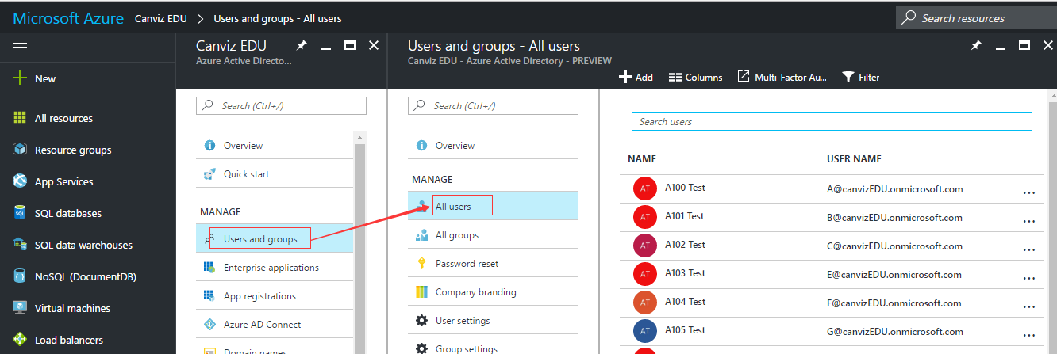
Update AD User Information
Click the Users and groups and then click All users. All users will show.

Slide 52
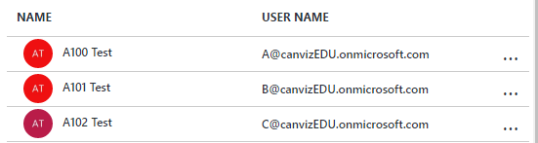

Update AD User Information
Click a user’s name and open the user detail page.
Click Profile will open edit profile page.
Update user information like Job title.
Save changes.
Notice:
An O365 user can only be synced after linked with a local account.
Only properties of Department, Job Title and Mobile can be synced.

Slide 53

Check Web Job Sync Result
Go back to web job log detail page.
Wait about 1 minute, then refresh the page.
Click the last function invoked to open the detail page.
Click the Toggle Output button.
View the log that shows one item was updated.

